Slide 1
How US legislation is harming Sex Workers Worldwide
An Occupational Health and Safety clinic for and by Sex Workers in San Francisco, California, USA.

Slide 2
What is the law in the US re: sex work?
Grey Area
BDSM
Sugar babying
Sex surrogacy
Professional cuddlers
Legal
Stripping
Webcamming
Sex toy shops
Porn
Illegal
Full-service escorting
Sensual Massage
Oral sex

Slide 4
Eros Guide raided by Homeland Security

Slide 5
What is SESTA and FOSTA?
“Stop Enabling Sex Trafficking Act” and “Fight Online Sex Trafficking Act”
Spring 2018
Bipartisan support
Explicitly includes consensual ‘prostitution’
Notes:
Main points:

Slide 6
What is SESTA and FOSTA?
Eliminates section 230 of Communications Decency Act
Websites legally liable for all content
Allows anyone to sue websites

Slide 7
Domestic Ramifications
Voluntary self-closure of ad sites & screening platforms
Widespread loss of income- panic among sex workers
Go to streets or don’t work at all?
Neighborhood complaints leading to increased policing
Actual trafficking much harder to find
Notes:
Screening platforms such as Verify Him,

Slide 8
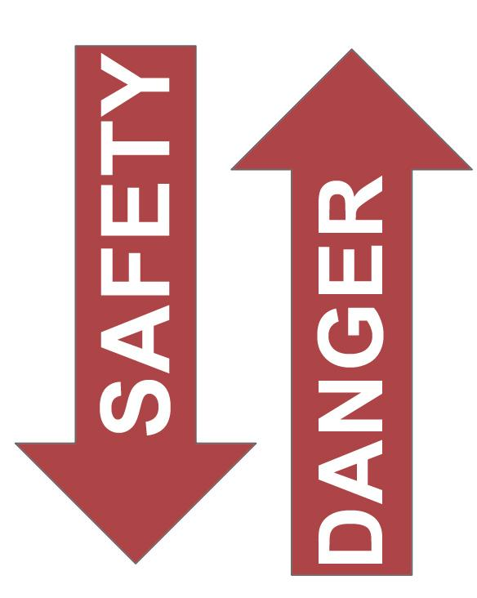
SUMMARY OF IMPACT
DECREASES IN:
Income for sex workers
Available clients
Screening practices
Worker bargaining power
INCREASE IN:
Risk taking by sex workers
Contact from “pimps”
Predators preying on desperation
Demands for cheaper services
Courtesy of Juliana Brown, COYOTE RI 2018

Slide 9
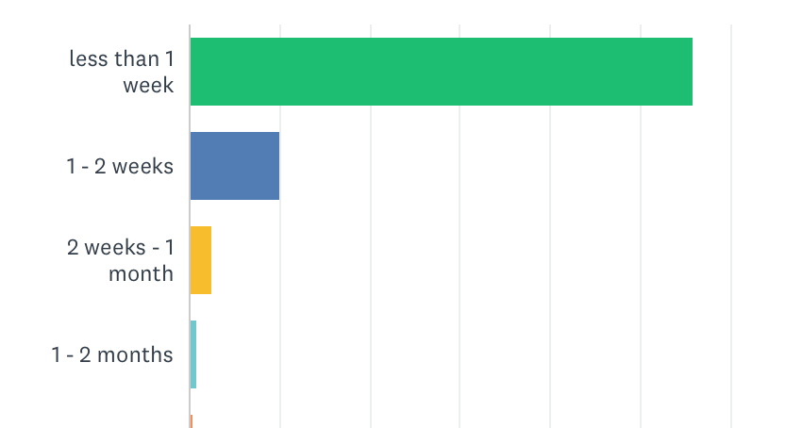
Backpage Closure and Loss of Income
How long after Backpage closed did you observe a change in your income?
How long was after backpage closed where you unable to support yourself and those dependent on you?
70% of participants (186 people) affected
* 70 people reported not yet being affected
45% of participants (117 people) affected
* 130 people reported still being able to support themselves and dependants
Courtesy of COYOTE RI, 2018

Slide 10
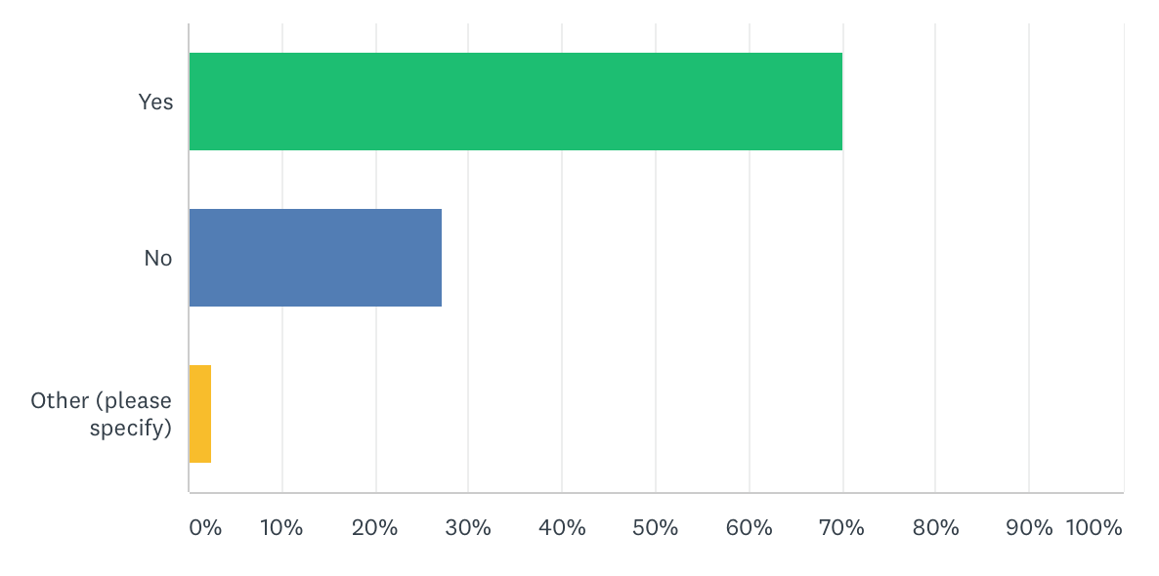
Sex Work as Sole Source of Income
Was Sex Work your only means of income before FOSTA passed?
70% of participants (188 people) cited sex work as their sole form of income, before FOSTA passed.
Testimonials:
“Being disabled it provided enough money to cover bills that my disability checks could not”
“I have other side hustles but sex work pays my rent and bills”
“I have always had mental and physical disabilities. Suicide is much more tempting now that my income and choice of profession is threatened.”
Courtesy of J. Brown, COYOTE RI, 2018

Slide 11
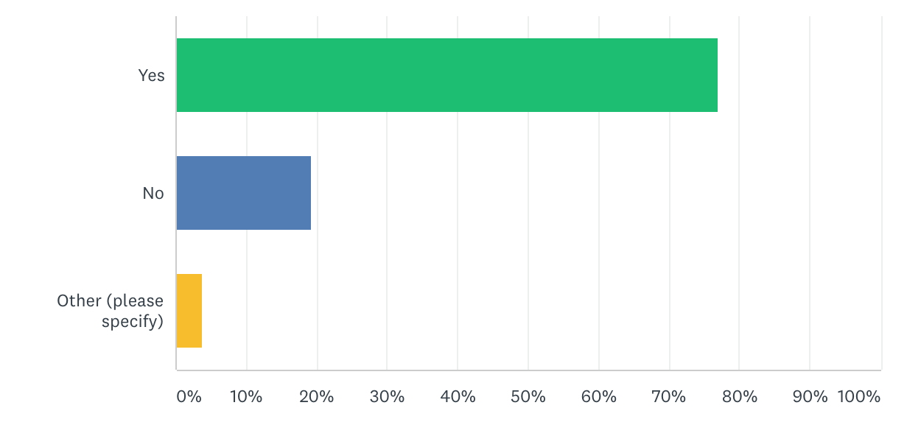
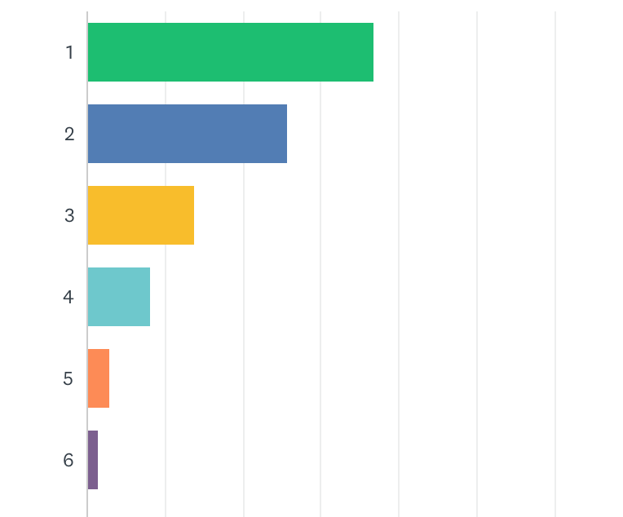
Sex Worker as a Breadwinner
Are you the sole provider for your family?
How many family members are you supporting?
77% of participants (207 people) reported being
The sole providers for their families.
89% of participants (239 people) claimed to be supporting between 1-6 dependants.
* 11% (30 people) claimed no dependants.
Courtesy of J. Brown, COYOTE RI, 2018

Slide 13
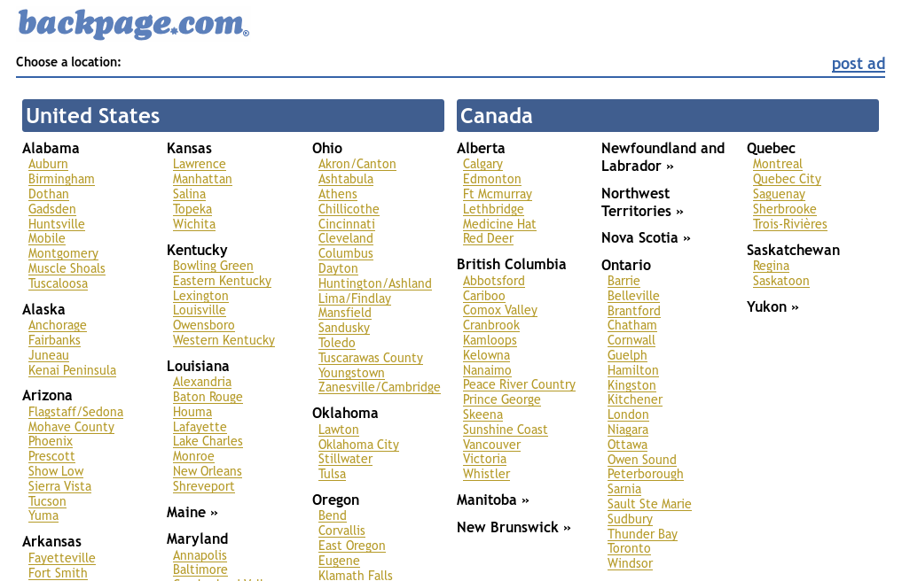

Slide 14
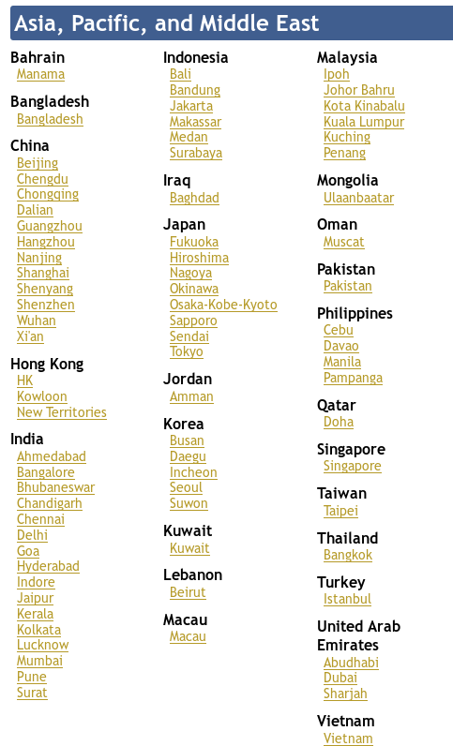
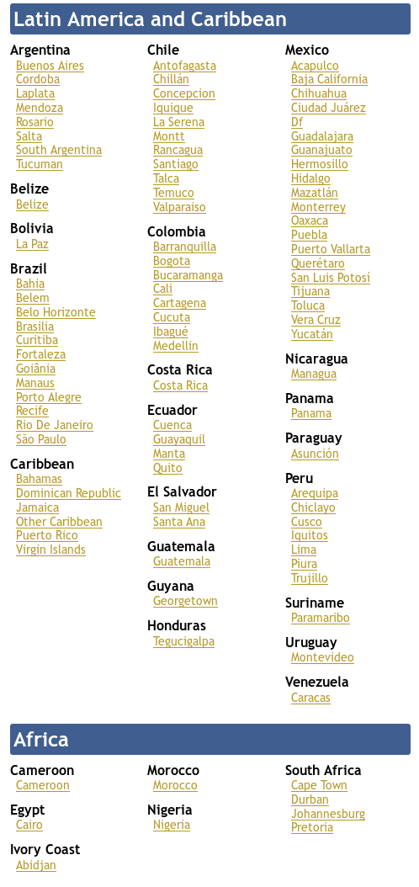

Slide 15
International fallout
Voluntary self-censorship of sites
Backpage shutdown
Adoption in other countries?

Slide 16
Australia (special thanks to Scarlet Alliance, Australia)
Increased “intense presentations” (dire need for support w/ housing, childcare, mental breakdowns, etc.)
Lower income
Fake classified ads popping up
Reduced access for older and gender non-conforming workers
Ad sites requiring legal ID
Increased street work = still criminalized, more competitive

Slide 17
What’s next?

Slide 18
FOSTA/ SESTA Pushback
Lawsuit
Community organizing and mobilizations
Defeat of California’s SB 1204
New discourse in media
Developing new safety harm reduction strategies
Renewed push for national anti-criminalization

Slide 19
New Threats
Localized attempts at further curbing sex work
S2080 “End Banking for Human Traffickers Act”
HR 2219 “End Banking for Human Traffickers Act”
Notes:
Localized attempts:
Virginia law denying bail
Oakland pushing Nordic Model
SF neighborhoods mobilizing against street workers

Slide 20
How can you help?
Center and include sex workers in all your work!
Ensure we have a seat at the table
Stand with us when we ask for support
Intersect your movement with ours

